Slide 1
Why We Need a Different Approach to Measuring Socio-Economic Progress
Diane Coyle
University of Manchester
17 February 2015

Slide 2
What are we trying to measure?

Slide 3
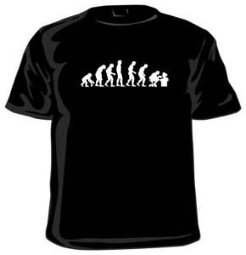
Progress?
Notes:
“Enlightenment thinkers believed that man emancipated by reason would rise to ever greater heights of achievement. The many manifestations of his humanity would be the engines of progress: language, community, science, commerce, moral sensibility and government.”
Charles Kenny, Hans Rosling, Steven Pinker – many authors observe march of progress continuing
But ‘end of growth’ narrative disagrees – economic limits – key element in current disillusionment with idea of progress? No more material needs; depletion of nature; dark side of science & technology.
And of course, crisis and its aftermath: the boom was unreal, the bust isn’t?

Slide 4
GDP – the hockey stick of history
Notes:
GDP from Maddison’s figures – tells the broad story of economic history

Slide 5
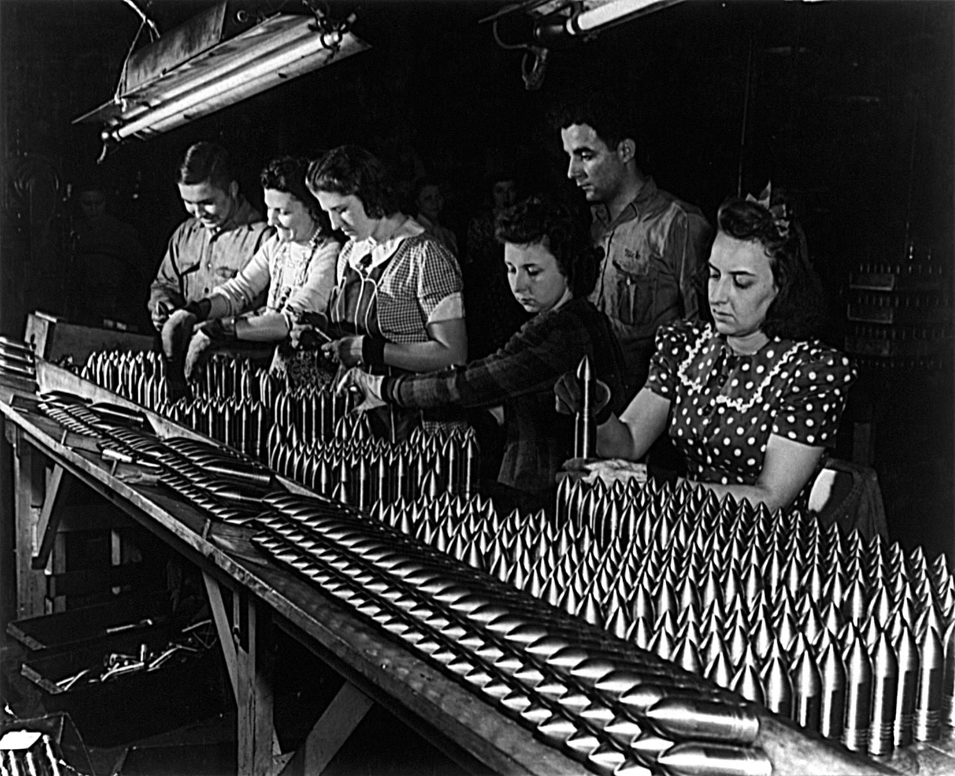
What is ‘the economy’?
What can be taxed to pay for wars?
What can be traded to increase national wealth?
Agriculture; manufacturing
How much spare capacity? GDP=C+I+G+(X-M)
Notes:
The questions posed have changed over the centuries
“The economy” a 20th century concept – 1920s and 30s; demands of war
Post-war development of standards
Many practical difficulties:
Data collection
Seasonality
Nominal and real – inflation adjustment
Quality adjustment – hedonic price indices
Exchange rates & purchasing power parity
Base year effects
Methodology for key sectors - finance, government

Slide 6
Known problems with GDP

Slide 7
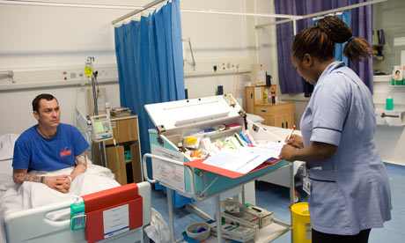
Government
Notes:
Production boundary – what’s in and what’s out?
Economic activity at market prices – no market in the public sector
Original estimates: output = sum of inputs; productivity growth defined away
Newer approach: try to add up outputs, use market prices to value them
Figures driven by nominal expenditure – if cut, looks like either more efficiency or lower quality, impossible to tell
Ambiguities about concept of productivity in services

Slide 8
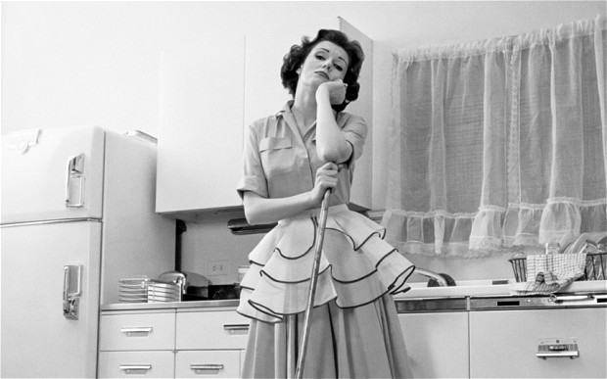
The informal economy
Notes:
Outside the production boundary – housekeeper paradox
Is it valuable or not?
Important areas of policy
Other voluntary activities now – large chunk of economy? (Wikipedia, blogs, Linux, “free” goods) – measurement problems
But also the gap between measured market activity and society’s welfare

Slide 9
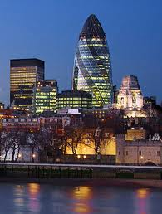
Finance
Notes:
Another example of the gap – in the other direction
Biggest contribution to growth – measures risk taking
Look at stock of outstanding loans that go to business or even housing

Slide 10


The welfare wedge

Slide 11
The intangibles wedge
Notes:
Our exciting new tech not electricity or railways but digital, and we’re starting to get an idea of how radical its effects will be.
But we can still say some things about it. One of the striking features Is that the value being created these days in the economy is intangibl.
Chart from ONS shows material used, literally the mass, of UK economy has been declining. But GDP has grown far more.
GDP doesn’t even capture a lot of the new sources of value.
It doesn’t measure variety at all – ‘more of the same’.
It’s not good at measuring innovation – never has been – because they transform lives. When Nathan Mayer Rothschild developed the tooth abscess that killed him in [year], he’d have paid a lot for an anti-biotic that would now cost a few pounds.
It doesn’t measure the value we get as users of all the free activities online – blogs, Skype, access to info, social networking – nor the listicles and trolling either
it’s a ‘more of the same’ and ‘product’ concept – prostitution but not housewives and carers, rebuilding but not the destruction of assets
And it doesn’t measure the ‘free’ (zero price) activity online, certainly not the value users get out of it
How should we think about intangible value – which evaporates overnight – and what should we be doing to create more of it?

Slide 12
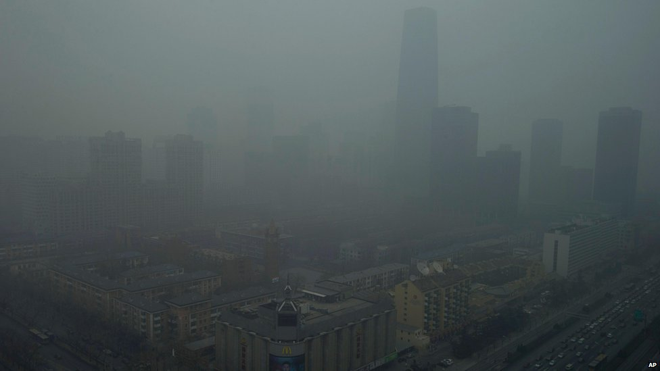
Sustainability
Notes:
Definition: can the current standard of living be reproduced by future generations?
Types of capital
National balance sheets
Measuring wealth

Slide 13
Solutions?

Slide 14
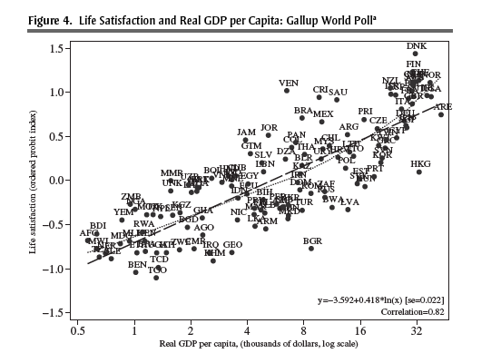
Alternatives to GDP: ‘happiness’
Notes:
Happiness is correlated with GDP growth

Slide 15
Social Progress Indicator - Ireland

Slide 16
Social Progress Indicator - UK

Slide 17
Dashboards
OECD commentary
Some BLI components
In Ireland, the average household net-adjusted disposable income per capita is 23 721 USD a year, less than the OECD average of 23 938 USD a year. But there is a considerable gap between the richest and poorest – the top 20% of the population earn more than five times as much as the bottom 20%
In Ireland, 73% of adults aged 25-64 have earned the equivalent of a high-school degree, close to the OECD average of 75%. In contrast to the overall OECD experience, more women have graduated high school than men, as 70% of men have successfully completed high-school compared with 76% of women. In terms of the quality of its education system, the average student scored 516 in reading literacy, maths and science in the OECD’s Programme for International Student Assessment (PISA), above the OECD average of 497. On average in Ireland, girls outperformed boys by 3 points, less than the average OECD gap of 8 points.

Slide 18
Comprehensive wealth
Notes:
Change – “genuine saving”

Slide 19
Comprehensive wealth comparisons
2005 US$

Slide 20
What should we measure, and why?
Three different aims: three kinds of measurement
Economic activity
    GDP?
Social welfare
    Dashboards?
Sustainability
    Assets – change in comprehensive wealth
Notes:
Multi-dimensional dashboards vs single indicator for media/public debate?

Slide 21
